Slide 1
MACHINE LEARNING with Python
Pandas, numpy, sci-kit learn, Classification , Clustering Models, Deployment of model
PRESENTED BY VALENTINA WALTERS TEBOH

Slide 2
What is DATA SCIENCE?
Data science is the study of data, involves manipulation of data in order to extract useful information from structured or unstructured data

Slide 3
DATA SCIENCE TOOLS(PANDAS, NUMPY, SCIKITLEARN, SYMPY)
Recently. libraries and modules have been created to automate and ease this data manipulation.
Pandas: Used for data analysis
Numpy ( numerical Python): Used for carried out mathematical and some statistical operations on data sets
Scikitlearn (Scientific Kit Learn): This is the library responsible for model, training, and prediction of data

Slide 4
WHAT IS MACHINE LEARNING
Machine learning involves the development of algorithms that make prediction of data based on inference or analysis of previous data.

Slide 5
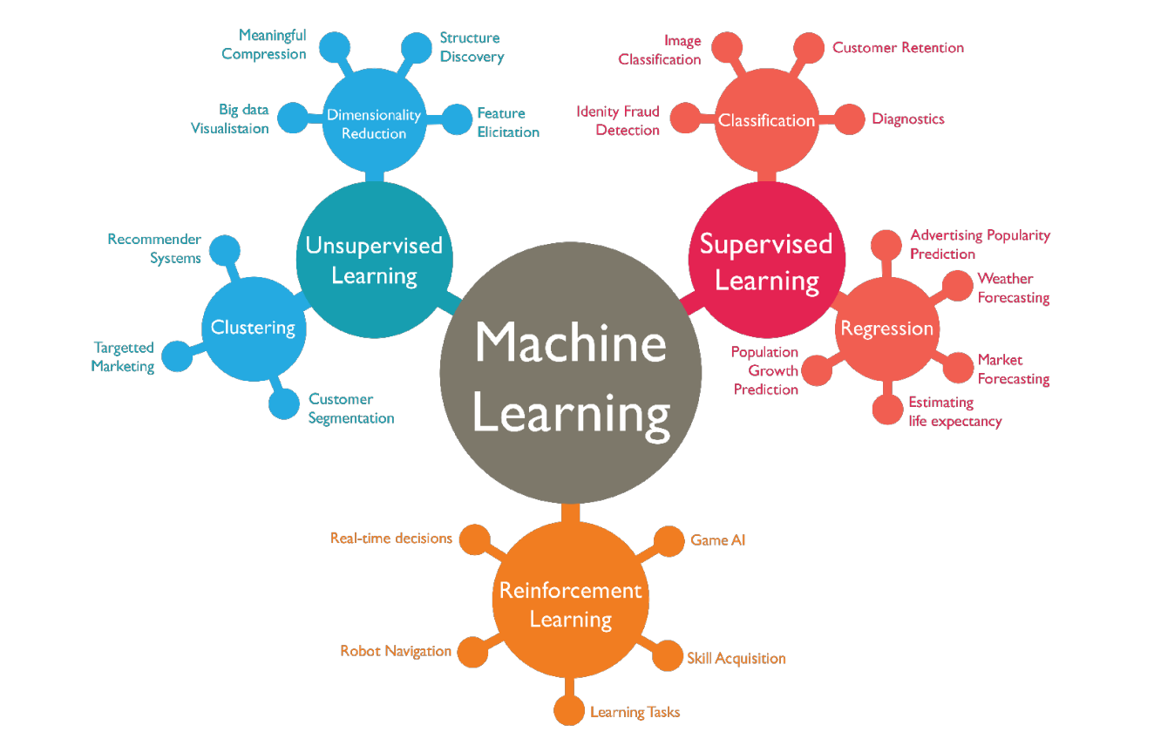
CLASSIFICATION OF MACHINE LEARNING

Slide 6
SUPERVISED LEARNING
Supervised learning involves making predictions based on both input and output data
The various Supervised learning algorithms are classified under regression and Classification:
Regression: Linear Regression, Logistic Regression
Classification; Support Vector Machines, Decision trees, K nearest Neighbour, Naïve Bayesian

Slide 7
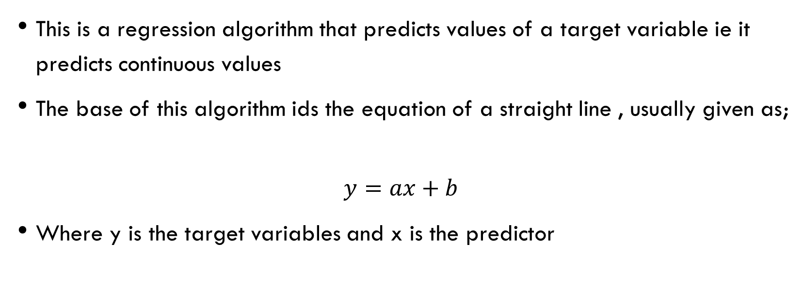
Linear Regression
This is a regression algorithm that predicts values of a target variable ie it predicts continuous values
The base of this algorithm ids the equation of a straight line , usually given as;
$$y=ax+b$$
Where y is the target variables and x is the predictor

Slide 8
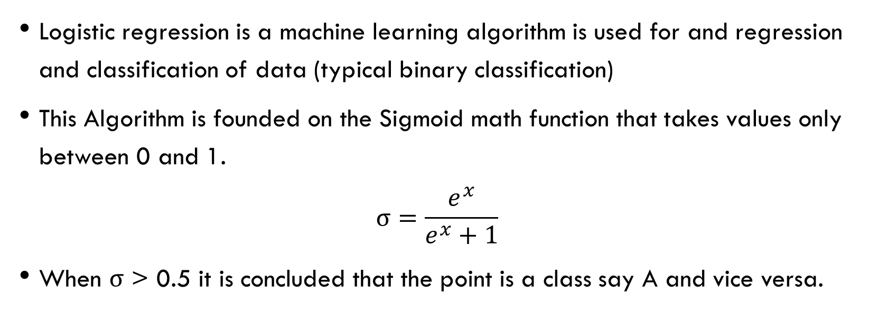
SUPERVISED LEARNING ALGOROTHMS Logistic ReGression
Logistic regression is a machine learning algorithm is used for and regression and classification of data (typical binary classification)
This Algorithm is founded on the Sigmoid math function that takes values only between 0 and 1.
$$σ=\frac{e^{x}}{e^{x}+1}$$
When $σ$ > 0.5 it is concluded that the point is a class say A and vice versa.

Slide 9
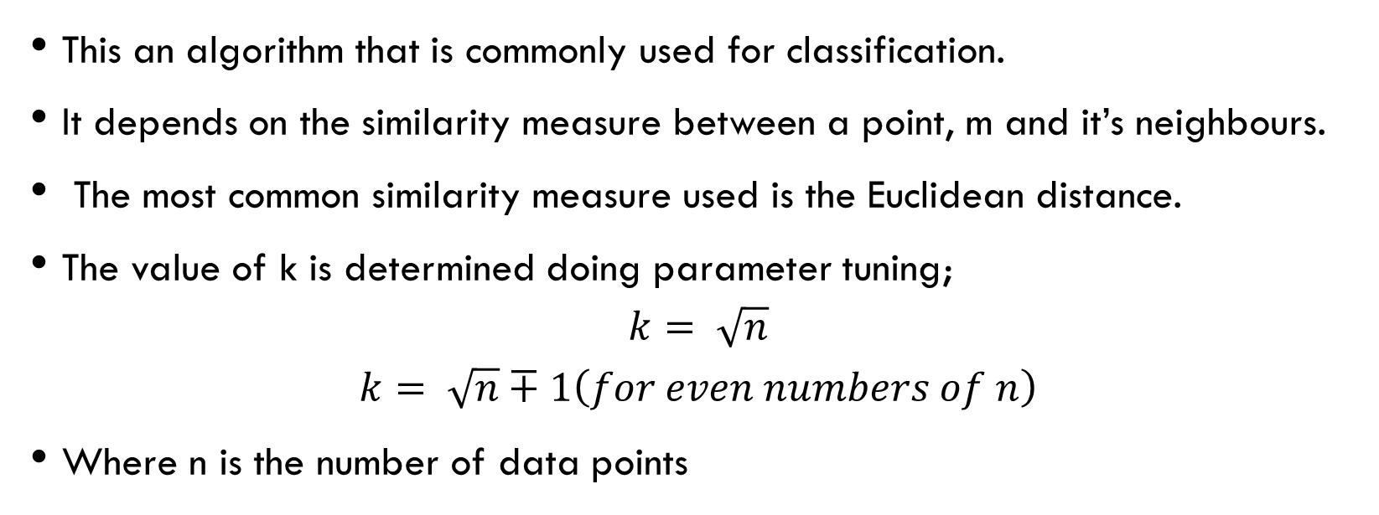
K nearest neighbour
This an algorithm that is commonly used for classification.
It depends on the similarity measure between a point, m and it’s neighbours.
The most common similarity measure used is the Euclidean distance.
The value of k is determined doing parameter tuning;
$$k= \sqrt{n}$$
$$k= \sqrt{n}∓1\left(for even numbers of n\right)$$
Where n is the number of data points

Slide 10
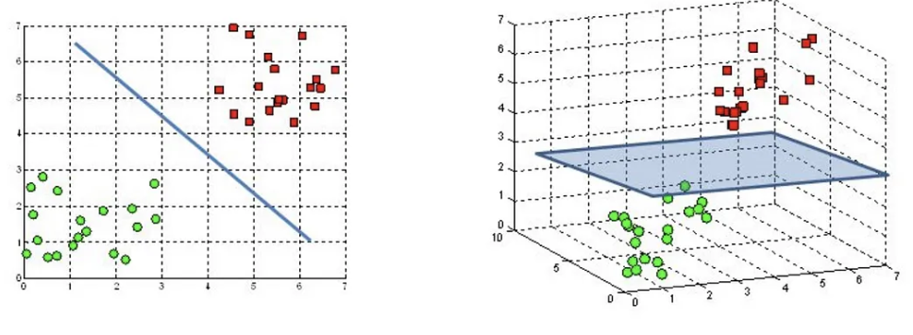
Support Vector Machine (SVM)
The objective of the SVM is to find the hyperplane or line in the N-dimensional space that distinctly classifies the data points.

Slide 11
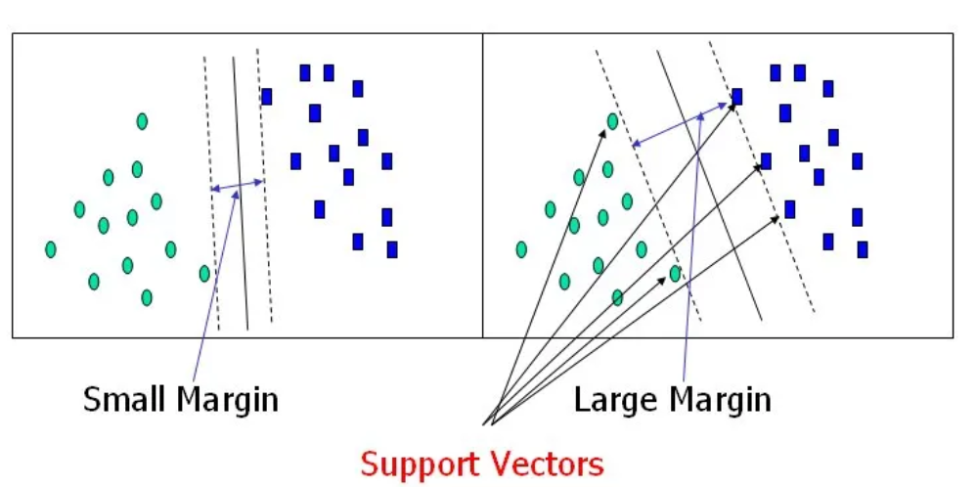
SVM Cont.
How do we determine this plane?

Slide 12
SVM Cont.
Most times the differentiation is not always clearly seen so there is a need for transformation from one dimension to the other.
Transformation is done from one dimension to the other in order to ease
The Kernel determines the transformation from one dimension to another
Other parameters like c and gamma are manipulated to get the best margin for accurate performance

Slide 13
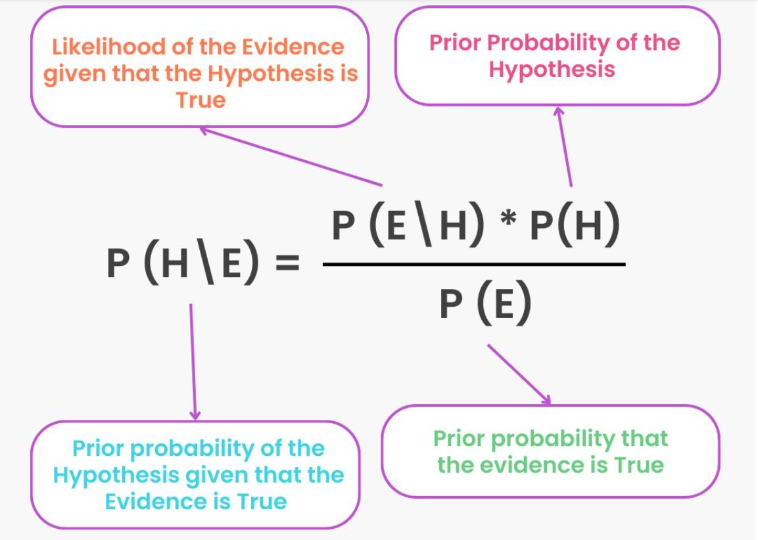
Naïve BAYESIAN ALGORITHM
What is the naïve Bayesian Algorithm? It is based on Baye’s Theorem

Slide 14
UNSUPERVISED LEARNING
An unsupervised learning method is a method in which we draw references from datasets consisting of input data without labeled responses. Generally, it is used as a process to find meaningful structure, explanatory underlying processes, generative features, and groupings inherent in a set of examples.

Slide 15
CLUSTERING
Clustering is the task of dividing the population or data points into a number of groups such that data points in the same groups are more similar to other data points in the same group and dissimilar to the data points in other groups. It is basically a collection of objects on the basis of similarity and dissimilarity between them.

Slide 16
K means Clustering
An iteration is run whereby, K number of clusters are created and evaluated based on the variations within the clusters.
These clusters are formed by choosing random centroids (which are data points too)
The value of K is determined by evaluating the variation between the clusters and the number of clusters

Slide 17
Affinity Propagation Clustering
Affinity Propagation creates clusters by sending messages between pairs of samples until convergence.
Other clustering models include;

Slide 18
DBSCAN CLUSTERING
The key idea is that for each point of a cluster, the neighborhood of a given radius has to contain at least a minimum number of points.
Parameters Required For DBSCAN Algorithm
eps: It defines the neighborhood around a data point
MinPts: Minimum number of neighbors (data points) within eps radius

Slide 19
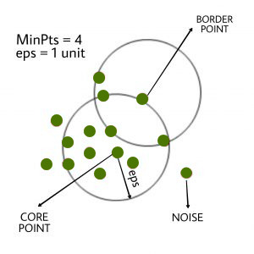
DBSCAN CLUSTERING
In this algorithm, we have 3 types of data points.
Core Point: A point is a core point if it has more than MinPts points within eps.
Border Point: A point that has fewer than MinPts within eps but it is in the neighborhood of a core point.
Noise or outlier: A point that is not a core point or border point.

Slide 20
Dimensionality reduction
Dimensionality reduction is the process of reducing the number of features (or dimensions) in a dataset while retaining as much information as possible.
It helps in data compression by reducing features. It reduces storage. It makes machine learning algorithms computationally efficient. It also helps remove redundant features and noise.
There are several techniques for dimensionality reduction; principal component analysis (PCA), singular value decomposition (SVD), and linear discriminant analysis (LDA)

Slide 21
Principal component anlysis
Principal Component Analysis (PCA) is a statistical procedure that uses an orthogonal transformation that converts a set of correlated variables to a set of uncorrelated variables. PCA is the most widely used tool in exploratory data analysis and in machine learning for predictive models.

Slide 22
Evaluating a Model(CONFUSION MATRIX)
A confusion matrix presents a table layout of the different outcomes of the prediction and results of a classification problem and helps visualize its outcomes.
It plots a table of all the predicted and actual values of a classifier.

Slide 23
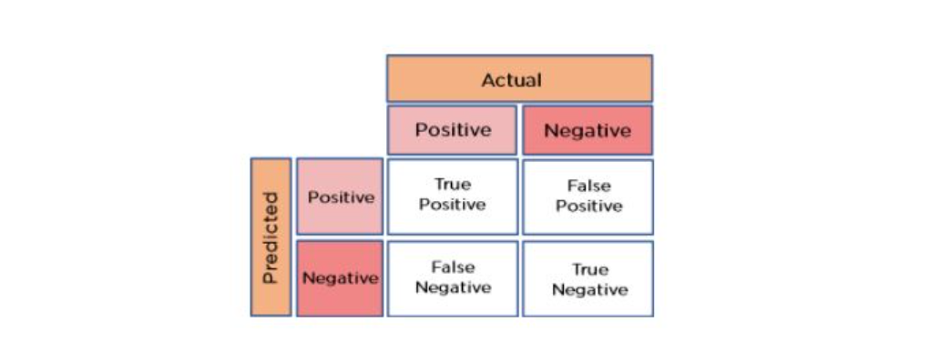
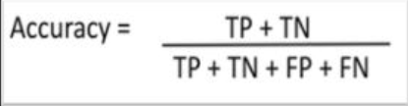
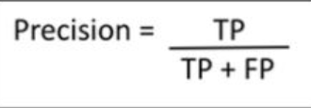
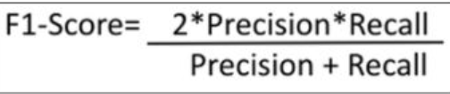

Confusion Matrix Continued

Slide 24
Deploying a machine learning model using flask and Gunicorn
Clone the Machine learning repository
Installed Gunicorn and Django
After following the Readme file’s instructions I was unable to deploy the model.

